Slide 1
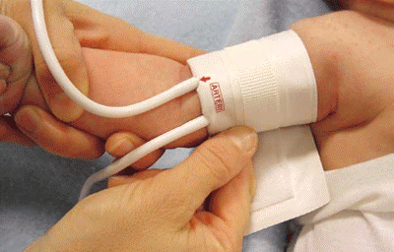
Infant blood pressure machine
principles of operation
function
use
scientific principles
construction
components
system diagram
inputs/outputs
troubleshooting
identifying common faults
replacing components
rectifying faults
18.3.4 Maintain an infant blood pressure machine
Unit C18.3 Maintaining Paediatrics Equipment
Module 279 19 C Medical Instrumentation II
©
dr. Chris R. Mol, BME, NORTEC, 2015

Slide 2
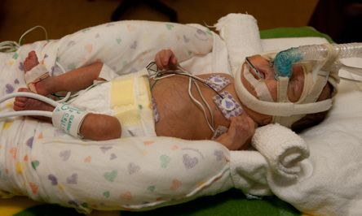
Pediatric use of blood pressure machine
The ‘pediatric use’ of a blood pressure machine is not very different from the ‘adult use’.
Therefore, this lecture will, for a substantial part, be a repetition of the lecture on blood pressure measurement in the General Bedside Nursing module of Medical Instrumentation I.
Maintain a blood pressure machine
dr. Chris R. Mol, BME, NORTEC, 2015

Slide 3
Measuring blood pressure
What is the blood pressure ?
Blood which is contained in a closed series of tubes, flows because of pressure inequalities in different parts of the circulatory system. High blood pressure when the blood comes out of the heart, increasingly lower as it goes through smaller arteries, and capillaries to reach the low pressure veins, leading back into the heart.
Why is it important ?
Blood pressure is one of the most important screenings because high blood pressure usually has no symptoms so it can't be detected without being measured. High blood pressure greatly increases your risk of heart disease and stroke.
What are normal values for
the blood pressure ?
The ideal pressure is between 120 mmHg systolic and 80 mmHg diastolic. Systolic pressures above 150 mmHg or diastolic pressures above 100 mmHg are of clinical concern. The difference between the systolic and diastolic pressures is called the pulse pressure. This generally runs between 40 and 50 mmHg.
What if a patient has abnormal blood pressure ?
Abnormal blood pressure can indicate malfunction in the heart, the resistance in the capillaries, the elasticity of the arterial walls or the volume of blood in the system. It can lead to stroke, heart attack, kidney problems and eye problems
Maintain a blood pressure machine
dr. Chris R. Mol, BME, NORTEC, 2015

Slide 4
Use
Blood pressure machines are used to determine the patient’s resting blood pressure, one of the primary diagnostic tools used by health care workers and used frequently.
In neo-nates:
prompt identification of hypo-tension potentially decreases the risk of complications from cerebral ischemic injury or intraventricular haemorrhage.
Although neonatal hypertension occurs less frequently, its identification is also important. Most hypertension in infants is related to renal (kidney) causes.
In rich countries, hyper-tension in older children (> 3 years of age) is, often related to overweight.
normal / average blood pressure value in children
Maintain a blood pressure machine
dr. Chris R. Mol, BME, NORTEC, 2015

Slide 5
Paediatric Use: cuff placement
1: Select the appropriate measurement site
Typically, the (right) upper arm is selected. When the infant's clinical condition or other factors (e.g., intravenous lines or percutaneous catheters) prohibit use of the upper arm, reassess the optimum site. This is also dependent on the infant's cardiovascular status and infant comfort.
2: Assess the chosen extremity
Do not place the cuff on a limb being used for intravenous or intra-arterial infusions or any area where circulation is potentially compromised. Use care when placing the cuff on an extremity being used to monitor other vital sign parameters, such as pulse oximetry, which also uses a pulse for determination of values.
Inspect the infant's limb before applying the cuff. Do not apply the cuff to injured skin.
©
Infant blood pressure machine
dr. Chris R. Mol, BME, NORTEC, 2015

Slide 6
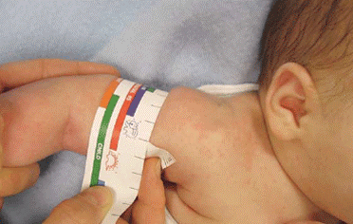
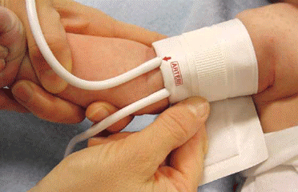
Paediatric Use: cuff placement
3: Select the proper cuff size
Adult-size cuffs are typically too large for children. This is because they cover too much of the arm, resulting in skewed readings that might indicate a problem when none exists. The most common mistake in cuff selection is choosing a cuff that is too small. This may result in erroneously high readings.
To ensure the cuff size and fit are appropriate, measure the infant's limb circumference by placing a measuring tape around the midpoint of the limb. Compare the infant's limb circumference to the circumference ranges marked on the cuff or its packaging.
4: Apply the cuff
Some cuffs have artery mark indicators to guide placement. To apply the cuff with an artery mark, palpate the infant's artery and then place the cuff so that the artery is aligned with the mark.
©
Infant blood pressure machine
dr. Chris R. Mol, BME, NORTEC, 2015

Slide 7
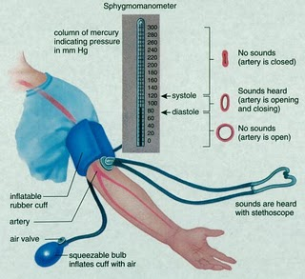
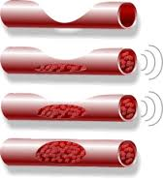
Scientific principles: Korotkoff sounds
The measurement of blood pressure is done by occluding an artery in the upper arm with an inflatable cuff that is connected to a (mercury) manometer. A stethoscope is used to listen for the Korotkoff’s sounds as the blood flows.
The first sound is heard as the pressure in the cuff goes below the systolic blood pressure.
The last sound is heard as the pressure in the cuff goes below the diastolic blood pressure.
The usual unit of measurement of blood pressure is millimetres of mercury (mmHg): 1 mmHg = 13.55 mmH₂O
200 mmHg = 200 x 13.55 = 2,710 mmH₂O = 2.7 meter H₂O
Therefore mercury , rather than water, is used in mercury manometer: a water column would need to be very high to be useful for bloodpressure measurements.
Infant blood pressure machine
dr. Chris R. Mol, BME, NORTEC, 2015

Slide 8
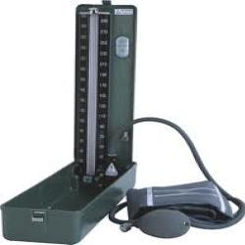
Mercury blood pressure system
To measure the pressure in the cuff, a mercury manometer can be used. A plastic or glass column with graduations from 0 to 300 mm is connected to the cuff via latex or rubber tubing. The tube is filled with mercury. The pressure reading is the height of the mercury column.
To get accurate readings the tube must be kept vertical.
Infant blood pressure machine
dr. Chris R. Mol, BME, NORTEC, 2015

Slide 9
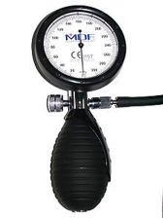
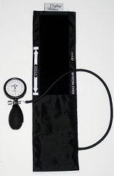
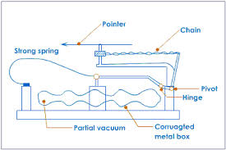
Aneroid blood pressure system
An aneroid manometer is based on a bellow and uses a calibrated dial.
Notice that when the dial is at zero, there is a small rectangle where the needle should rest.
Infant blood pressure machine
dr. Chris R. Mol, BME, NORTEC, 2015

Slide 10
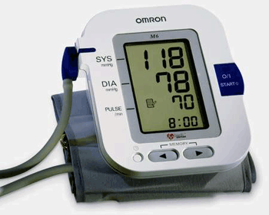
Non-invasive blood pressure Machines (NIBP)
Non-invasive blood pressure machines (NIBP) are devices that automatically and electronically measure blood pressure. In these systems, electronics replaces a human in the inflation/deflation of the cuff and automatically detects the Korotkoff sounds.
A microphone is located inside the cuff. It has a sensitivity at the frequency of Korotkoff sounds. The microphone is usually a piezo-electric crystal, which produces electrical signals when under pressure. Because of the low milliVolts output of such transducers, high quality microphone amplifiers are needed, capable of rejecting noise and low frequencies.
The measurement procedure with NIBP is the same as in manual methods: the cuff is (automatically) inflated to above systolic pressure and then the release valve is slowly opened. The pressure reduces until the microphone picks up the Korotkoff sounds. This is shown on an indicator lamp and a sound alarm is emitted. This is the systolic pressure. When the sounds stop (and also the Korotkoff indicator light goes off) then the diastolic pressure is read from the gauge. When fully automatic, the results are displayed in digital format.
Infant blood pressure machine
dr. Chris R. Mol, BME, NORTEC, 2015

Slide 11
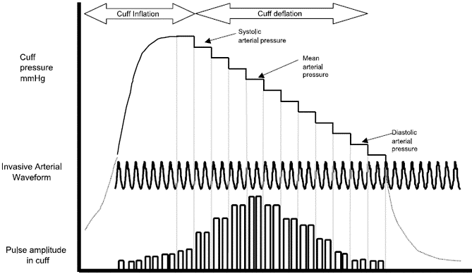
Non-invasive blood pressure Machines (NIBP)
Automatic ‘oscillometry’ is often used in new-born intensive care units. It has no observer variation and a better accuracy compared to stethoscope methods.
Auscultatory devices are not often used in infants because the Korotkoff sounds are often unobtainable.
Artefacts may arise from patient motion
Mean Arterial Pressure (MAP) is a standard measure of automatic blood pressure machines
Infant blood pressure machine
dr. Chris R. Mol, BME, NORTEC, 2015

Slide 12
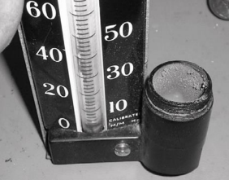
Trouble shooting
Manual blood pressure machines are extremely reliable. They are also inexpensive. They are often replaced rather than repaired. There are a few common problems.
Leaks in the tubing are common and can often be repaired with epoxy or silastic. To check for leaks, inflate the cuff to 250 mmHg and allow it to stand. The pressure should slowly decrease at a rate not exceeding 5 mmHg per minute. If there is a leak, you can find it by rubbing soapy water over the tubing and looking for bubbles.
User errors related to calibration are somewhat common. The cuff must be at the level of the heart (for mercury manometer) and the manometer must read zero before the cuff is inflated (all manometers).
In mercury manometer: check the cleanliness of the mercury. After many years of use, mercuric oxide will form, distinguishable by a black powder. The mercury, the mercury reservoir, and tube will all need to be cleaned. Keep in mind that mercury is toxic and care should be used to not release any into the ground or building.
In the photo, the cover for the mercury reservoir has been removed (right). The mercury has oxidized leaving a fine powder that should be removed before refilling the reservoir.
Infant blood pressure machine
dr. Chris R. Mol, BME, NORTEC, 2015

Slide 13
Trouble shooting
Automatic, non-invasive blood pressure machines (NIBP’s) are more difficult to calibrate than the others because the need to detect the Korotkoff sounds to function. If you do not have a phantom arm, then the best approach is to use your own arm.
Borrow a stethoscope and measure your own blood pressure. If you are not confident that you can use a sphygmomanometer accurately then ask someone else to measure it. Repeat the measurement five times.
Then connect yourself to the NIBP and measure your blood pressure five times. The average diastolic and systolic pressures from the two systems should match to within 3 mmHg.
Electronic blood pressure devices will have a zero setting which should never need to be adjusted, if the device is properly zeroed before each use. The most common problem is the use of the incorrect size cuff. If the correct cuff is being used, and if the transducer is located in the cuff itself, it may be possible to access the transducer with some difficulty. However, repair often requires specialized knowledge, as the manufacturer’s designs vary considerably.
Infant blood pressure machine
dr. Chris R. Mol, BME, NORTEC, 2015

Slide 14
Calibration
The most critical element to calibrate is the pressure measurement. A manometer can be tested:
against a known good manometer,
against a mercury manometer, or
against a simple column of water in an IV tube.
A simple pressure standard can be made by creating a column of water in a tube. Taping a tube to the wall and filling it with water up to a height of 271 cm, for example, creates a pressure standard of 200 mmHg (the density of mercury is 13.55 times that of water). Before releasing the blood pressure machine, check several pressure levels (200 mmHg, 100 mmHg and 50 mmHg – or 271 cm H20, 136 cm H20 and 68 cm H20, respectively). The manometer should be accurate to within 1-3 mmHg.
If the pressure is consistently too high or too low, you will need to adjust the zero by removing or adding mercury or twisting the manometer face (if aneroid).
Aneroid sphygmomanometers are considered safer than mercury based, although inexpensive ones are less accurate. A major cause of departure from calibration is mechanical shocks. Aneroids mounted on walls or stands are not susceptible to this problem.
Infant blood pressure machine
dr. Chris R. Mol, BME, NORTEC, 2015

Slide 15
END
The creation of this presentation was supported by a grant from THET:
see https://www.thet.org/

